Slide 1






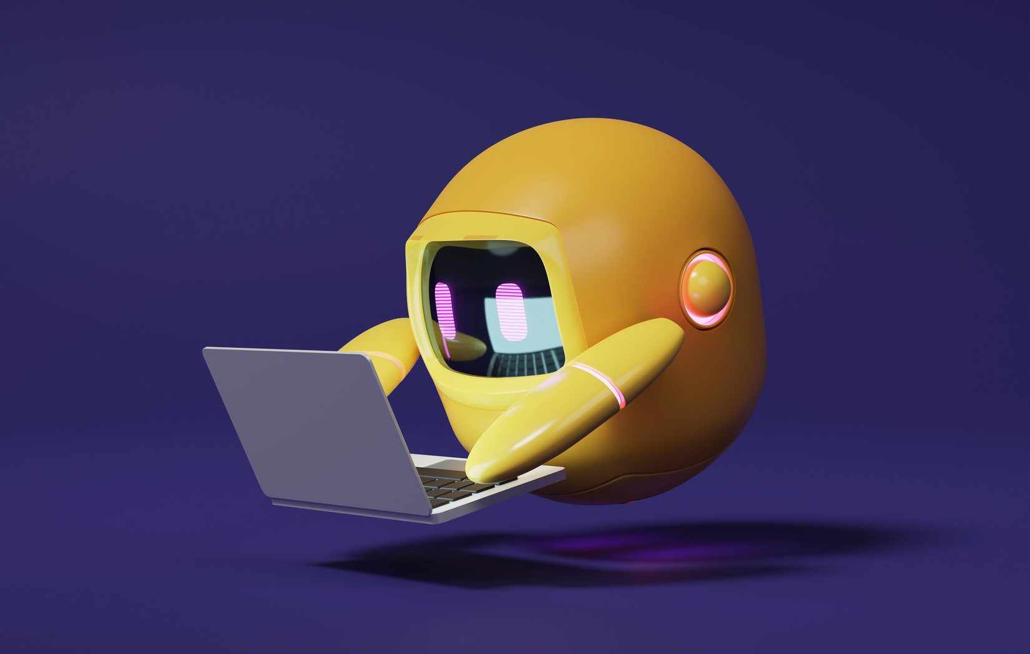

StudyBuddy – A Smart Chatbot for Students
A 2-days National Level Hackathon on
AI in education
SELECTED AREA NAME
Code Hashira
Anshul Soni(Team Leader)
Aarti Keswani
Adarsh mishra
Date of submission 05/09/2025
Gandhi Nagar Bhopal
www.samadhan.sistec.ac.in/

Slide 2
Problem Statement
Students face delays in accessing accurate academic resources. Existing methods (books, teachers, search engines) are either time-consuming, inconsistent, or unreliable. This gap highlights the need for an AI-driven academic assistant that ensures instant, contextual, and reliable support

Slide 3
Objectives
Develop an AI-based study helper chatbot.
Provide a user-friendly interface for students.
Enable real-time responses via backend server.
Interactive chatbot for study-related questions.

Slide 4


AREA OVERVIEW
StudyBuddy is a web-based chatbot designed to help students with study-related queries.
Acts as a virtual study assistant for quick and interactive learning.
IMPORTANCE OF AREA
* “StudyBuddy provides instant, 24×7 academic support to students, saving their time and making learning interactive.” * “It reduces dependency on teachers/books and promotes smart, self-learning through AI-based assistance.”

Slide 5
Technology Stack
Frontend: HTML, CSS, JavaScript
Backend: Node.js, Express.js
Environment Config: .env for settings/API keys
JSON for data handling

Slide 6
System Architecture
[User interacts with chatbot interface (Frontend)] │
[Frontend sends request to Backend (server.js)]
[Backend processes request using chatbot logic]
[Response is generated and displayed to the user]

Slide 7
Workflow
User (Student)
Chat UI (Frontend: HTML, CSS, JS)
Backend (Node.js + Express)
Chatbot Logic / API
Response Displayed in Chat Interface

Slide 8
Features
Chat interface for student queries.
Fast and responsive design.
Simple and user-friendly system.
Can be extended with AI/ML for better answers.
Enabled with the RAG layer, it will answer only study-related queries.

Slide 9
Results
The StudyBuddy project successfully developed a fully functional chatbot web application that delivers real-time responses to student queries. Its simple and user-friendly interface makes it highly effective and accessible for learners, ensuring an easy and interactive study experience.

Slide 10
Future Scope
Integrate AI/ML for smarter answers.
Add database support for saving previous chats.
Multi-language support.
Voice-enabled chatbot.

Slide 11
Conclusion
StudyBuddy acts as a helpful study companion.
Provides instant and interactive solutions for students.
Has strong potential for future enhancements.

